Slide 1
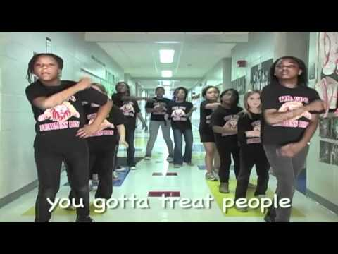
Assembly with Mrs Reid
16th March 2022

Slide 2
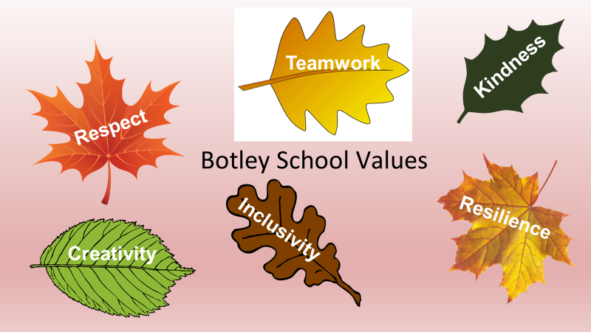

Slide 3


What is Respect?

Slide 4
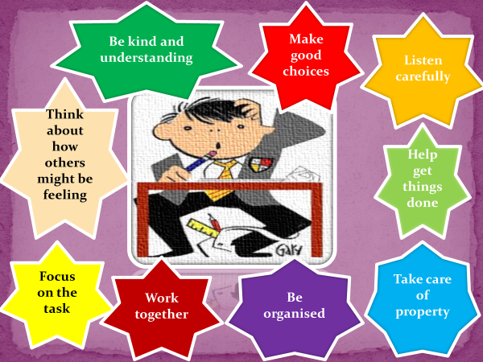
Last Year we talked about how to show respect in school.

Slide 5

What happens when we disagree?
Can we learn to disagree well?

Slide 6
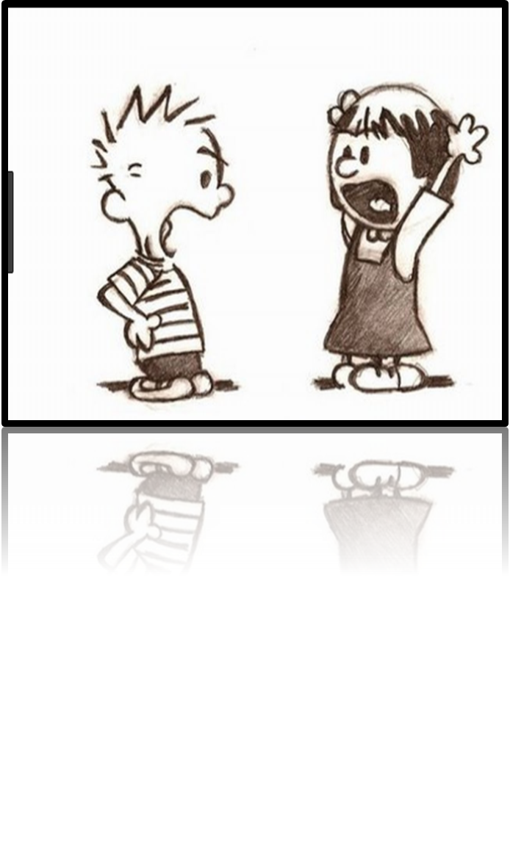
Everyone has a disagreement with their friends, family or work colleagues at some time.
No one can agree with everything all the time because we are individual, unique humans with individual, unique thoughts and opinions.
This is normal!

Slide 7
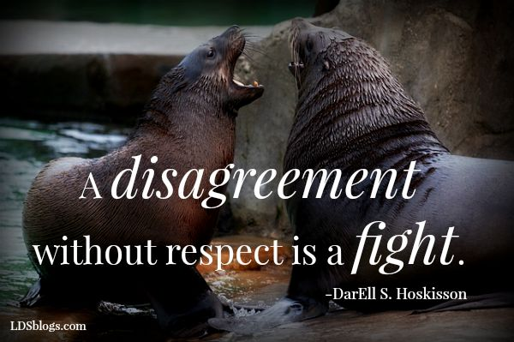

Slide 8
So how can we use language to help us disagree well and show RESPECT to our friends and family?

Slide 9
Language for disagreeing well
Excuse me, I beg to differ because...
I don't agree with what you've said because...
I'm sorry, I can't share that view because...
With all due respect, I do not think that is correct because...
I heard what you said, but I can't agree with you because...
Whilst I agree with some of what has been discussed, I don't think it is true because...
Whilst I understand the point you are making; I don't think it is correct because...

Slide 10
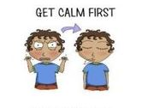
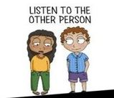
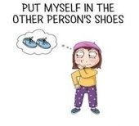
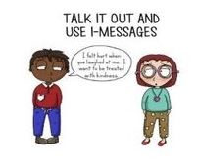
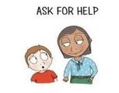
How else can we find ways to be respectful when we disagree?

Slide 11
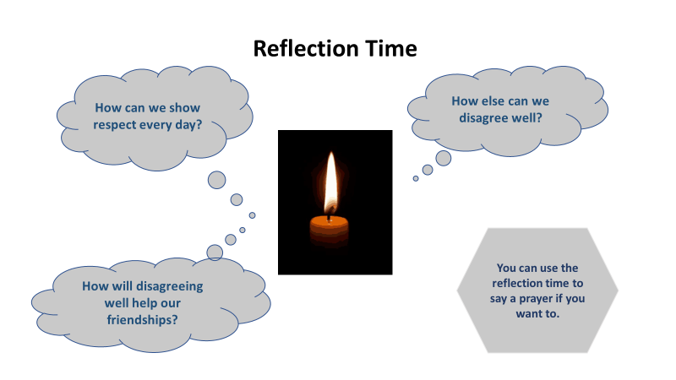
I wonder...

Slide 12
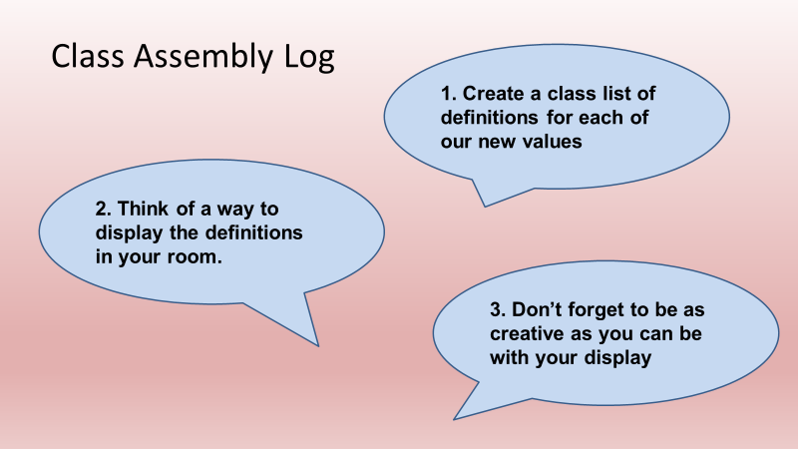
How are you getting on?

Slide 13
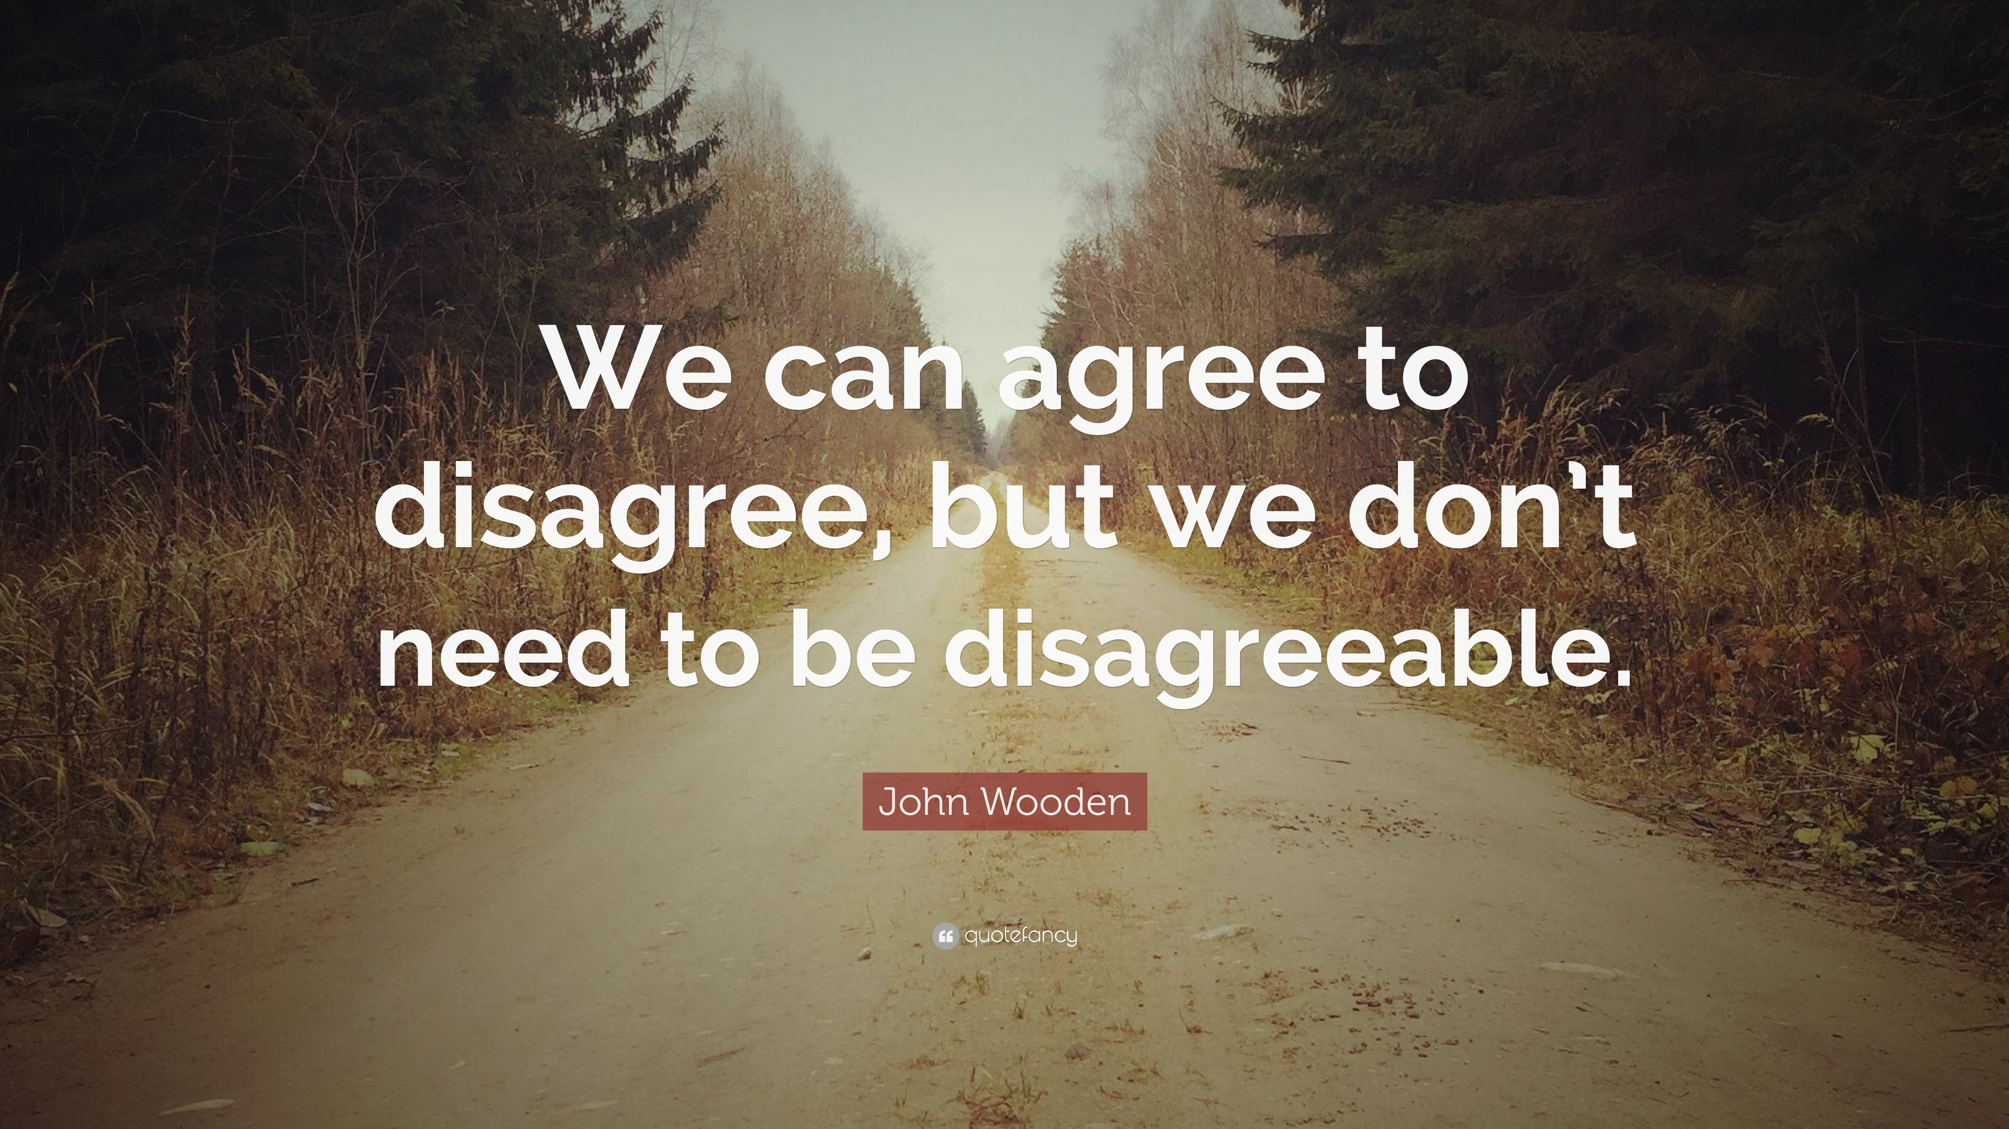
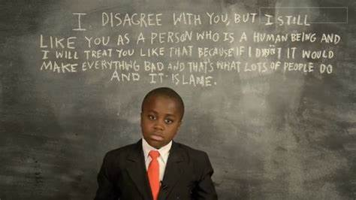
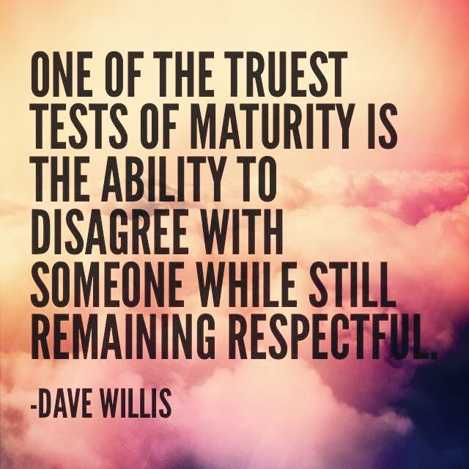
Final thoughts

