Slide 1
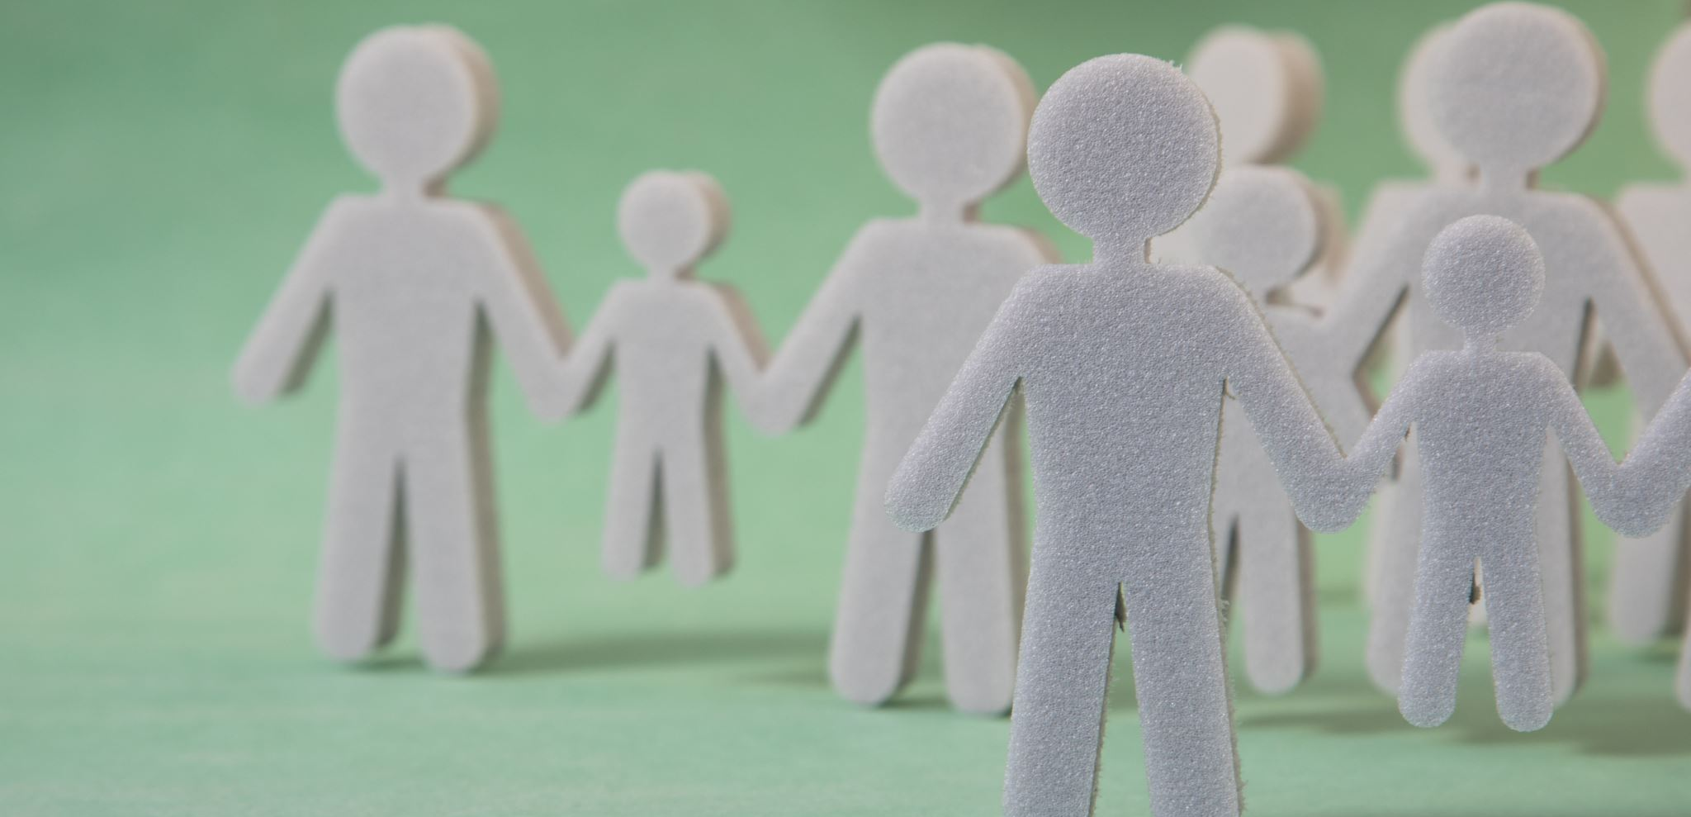
Assembly with Mrs Reid
Tuesday 26th April 2022

Slide 2


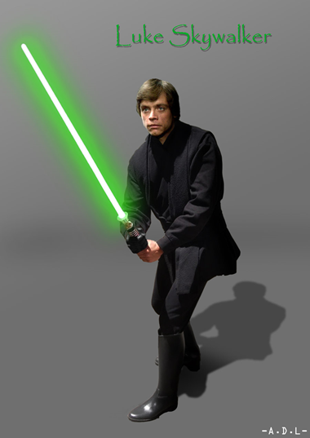

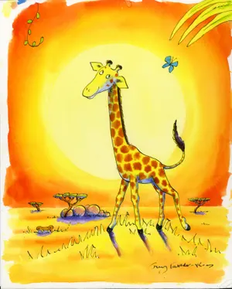

What do all these characters have in common?

Slide 3
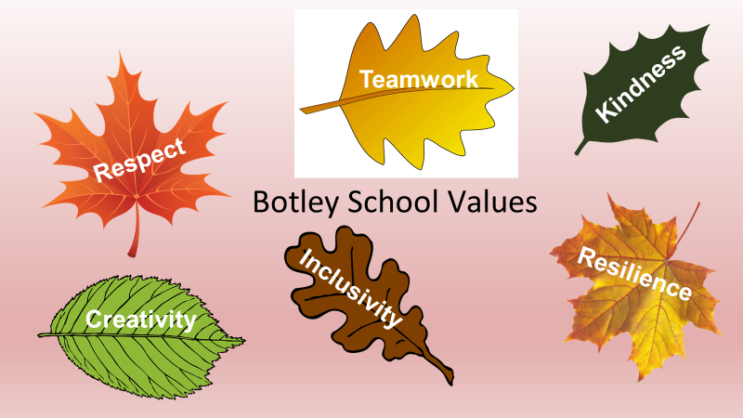

Slide 4

All the characters in slide 2 have overcome various obstacles that could have stopped them achieving their potential.
They did this by being resilient.

Slide 5
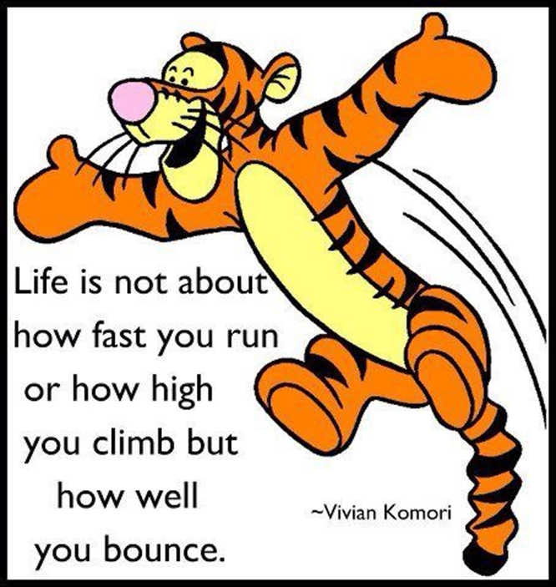
So, what does Resilience mean?
The capacity / ability to recover quickly from difficulties, and tough situations

Slide 6

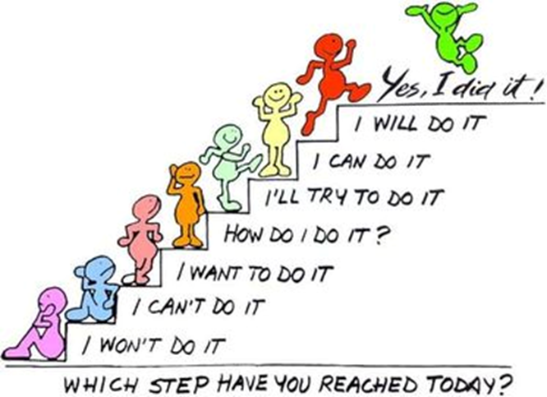
Where do you sit on the stairs?

Slide 7

I wondered, as a school, how resilient do we think we are? We could do a quiz to find out – shall we?
QUIZ: HOW RESILIENT ARE YOU? - CBBC - BBC

Slide 8
Useful phrases and how to use them
Don’t let this get you down.
We cannot always get 100% on every test. As long you gave it your best, be proud of what you achieve and learn from your mistakes for next time

Slide 9
Useful phrases and how to use them
Who have you spoken to about it
Talking through a problem can help clarify a problem and formulate a solution

Slide 10
Useful phrases and how to use them
What can you take from this, to stop it happening again
A problem can be a chance to find a solution to stop it reoccurring

Slide 11
CLASS Log: What Useful phrases can you think of for your class and how would you use them
?
?

Slide 12


