Slide 1
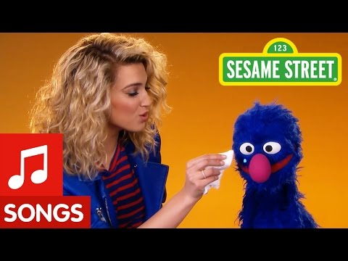
Assembly with Mrs Reid
Tuesday 17th May 2022
Kindness

Slide 2


Slide 3


Slide 4

“No act of kindness, however small, is ever wasted.”
- Aesop
Notes:
Can you find a copy of this fable and read it as a class. I wonder if you can tell me what the random act of kindness in the story is? What is the consequence of that act of kindness? What can we learn from the fable?

Slide 5
kindness
[ˈkʌɪn(d)nəs]
NOUN
the quality of being friendly, generous, and considerate
Tender-heartedness
Care
Gentleness
Thoughtfulness
Understanding
Helpfulness
Selflessness
Friendliness
Courteousness

Slide 6
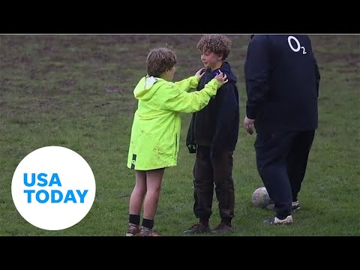

Slide 7
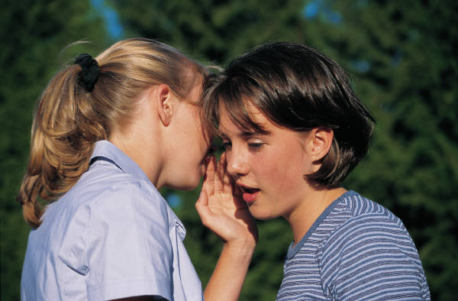
Be unfailingly polite to every single person that you meet
Swap places with the person behind you in the queue
Say something nice about someone without being prompted

Slide 8
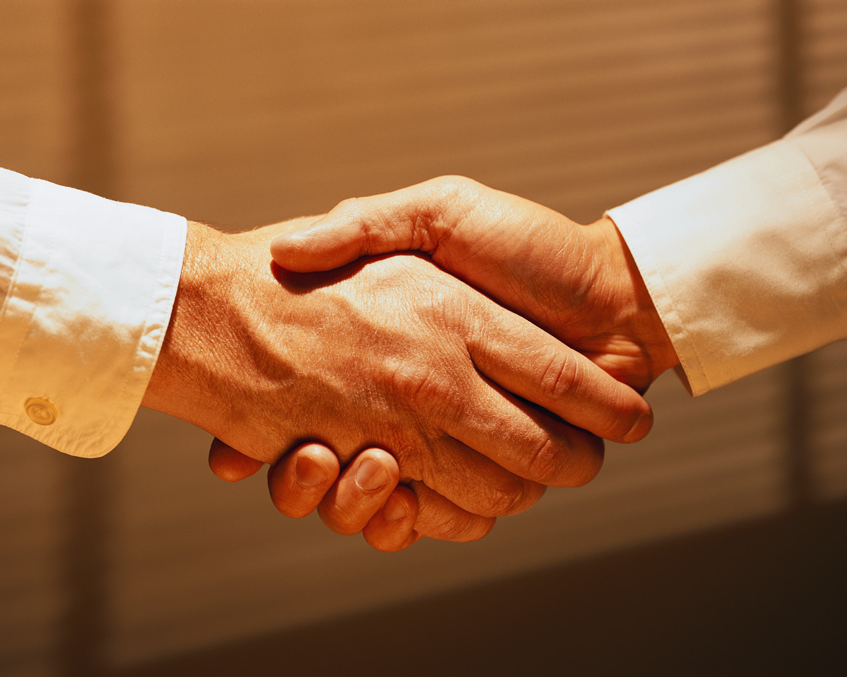
In PE, cheer for someone you don’t know
Forgive someone
Listen to someone’s problem without immediately comparing it to one of your own

Slide 9

Give up your seat for someone on the bus
Find some old books you don’t want any more and pass them on to someone who might not have read them

Slide 10
Phone an elderly relative and talk to them for a minimum of ten minutes
Smile at everyone you see
Pick up some litter – even if it’s not yours!

Slide 11
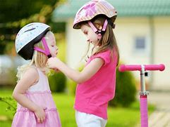
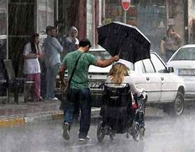
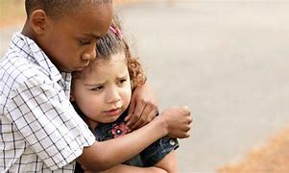
Class log: Can we find out how kind we are in school?
  1: Start a kindness poster in your classroom
  2: When you 'catch' someone else being kind – write it up on the poster
How many people will be 'caught' being kind today? This week? This term?

Slide 12

Reflection Time: I wonder…
How can we lend a hand to others this week?
How many times we can share a smile or a kind word with our friends?
How many acts of kindness will we all show everyday?
How can we make our lives, and those of everyone around us happier?
If you wish you can use the time to pray

Slide 13
School Reflection
This is our school,
Let peace dwell here,
Let the place be full of contentment,
Let love abide here,
Love of one another,
Love of humankind,
Love of life itself,
Let us remember that, as many hands build a house,
So many hearts make a school.

Slide 14

Final thought… Can you

