Slide 1


Assembly with Mrs Reid
Tuesday 22nd March 2022
Diversity and Inclusivity

Slide 2
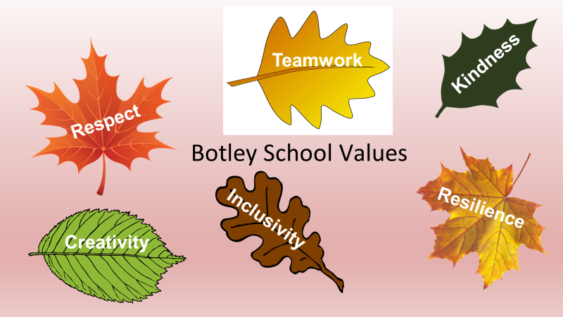

Slide 3


Slide 4
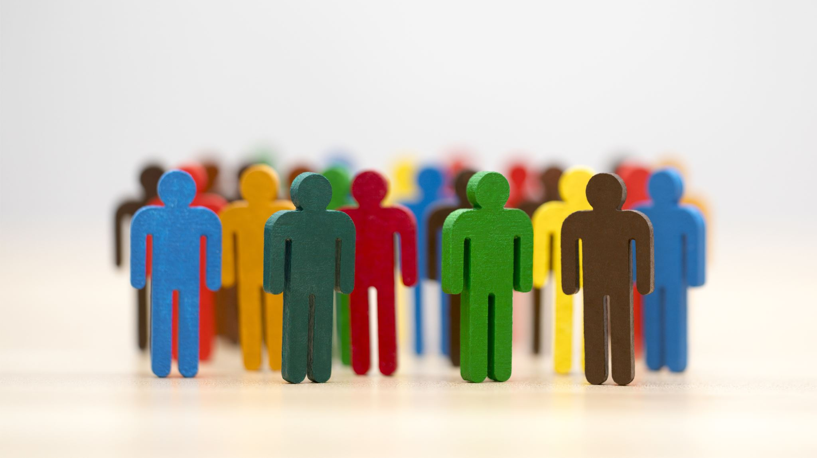
What is diversity?
What is inclusion?

Slide 5

The Same But Different Too.

Slide 6
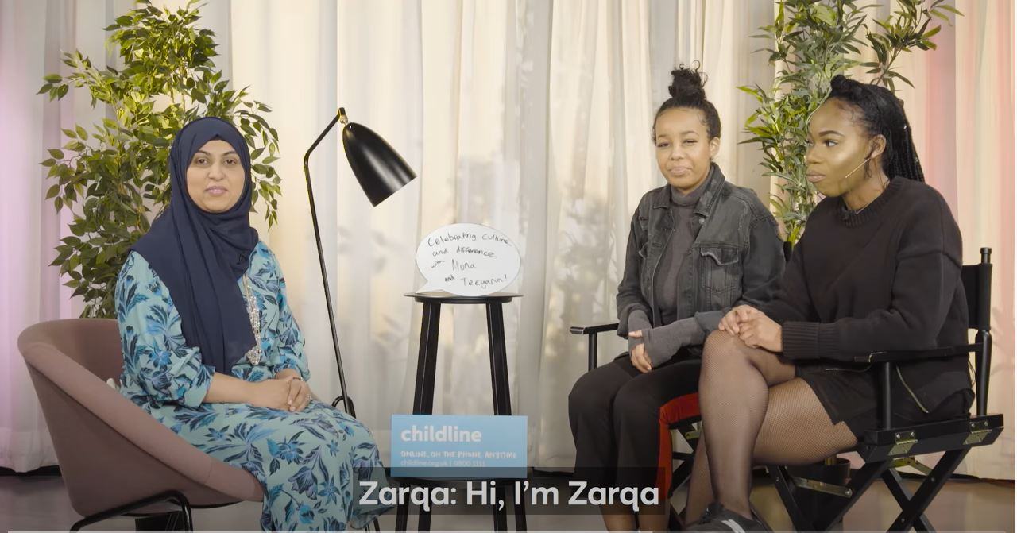
Celebrating Culture and Differences ft. Muna and Teeyana

Slide 7
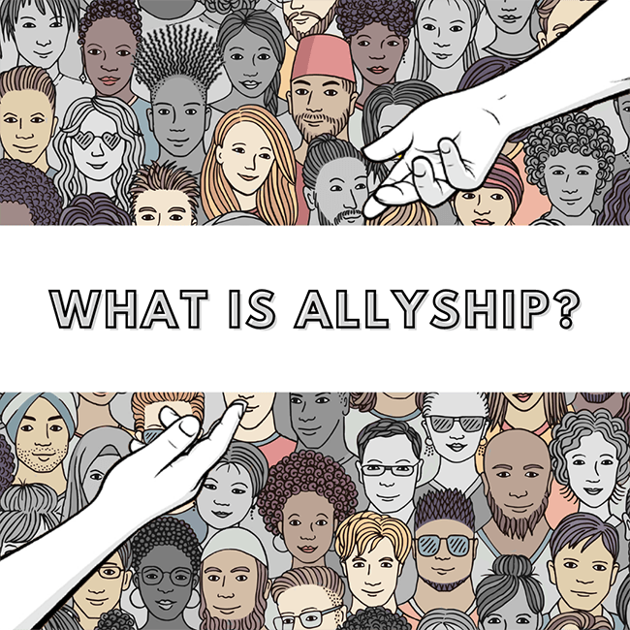

Slide 8
Assembly Log: Diversity and Inclusivity
What can we do to make sure everyone feels included and be an ally?
Make a list of ways we can ensure everyone feels welcome and celebrated at Botley School and display them in your classroom.

Slide 9
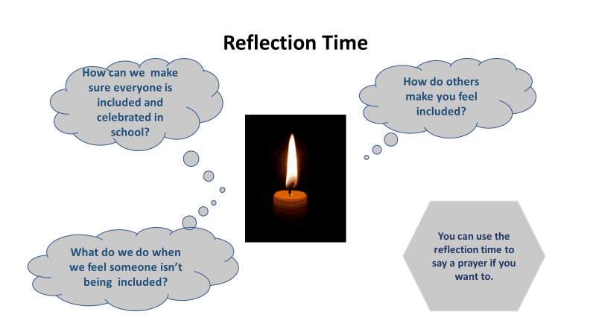

Slide 10
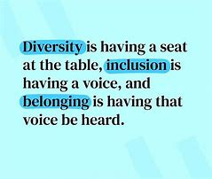
Final Thought

Slide 11
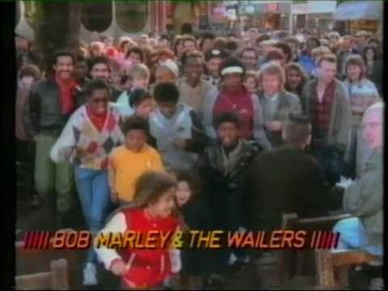
'One Love' by Bob Marley.

