Slide 1
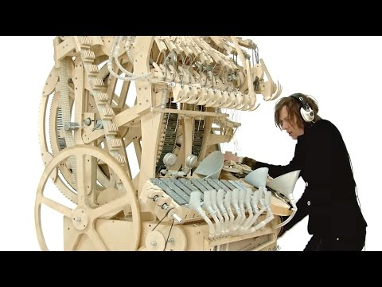
Assembly with Mrs Reid
3rd May 2022
Creativity

Slide 2


Slide 3


Slide 4
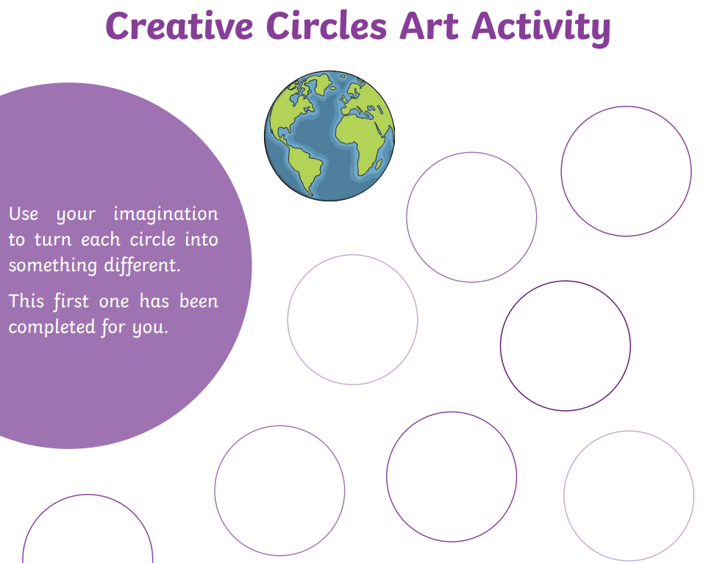
Creative Circles

Slide 5
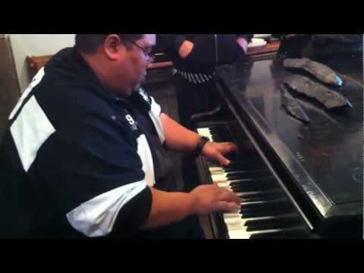
Musical creativity

Slide 6
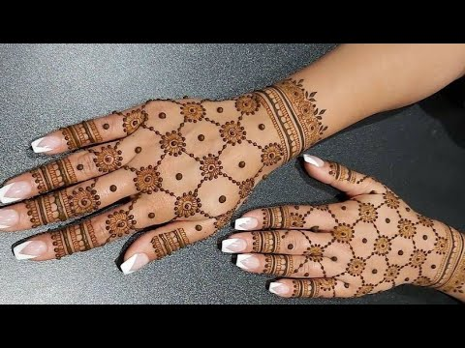
Religious Creativity

Slide 7
Assembly Log
How are we creative in our classes?
Can you make a list of how you have been creative in school or at home?

Slide 8
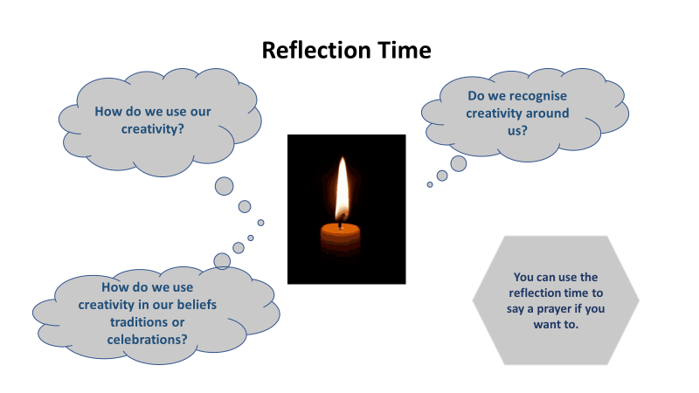

Slide 9
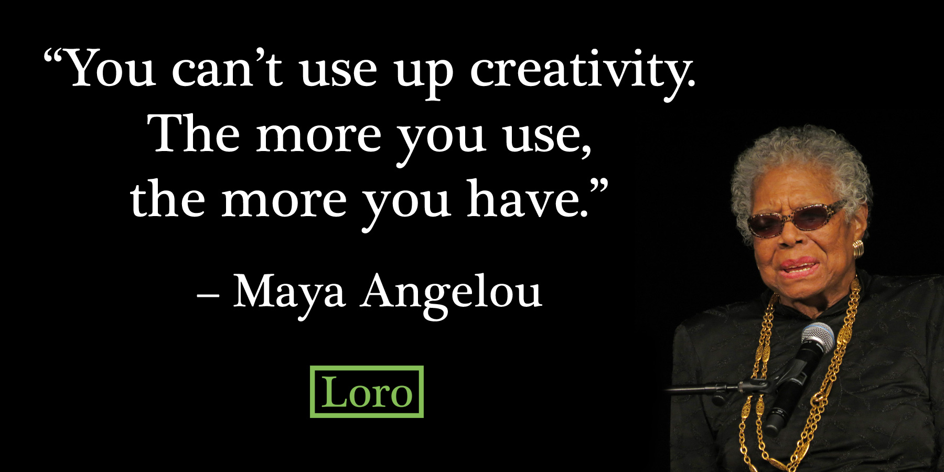
Final thought

