Slide 1
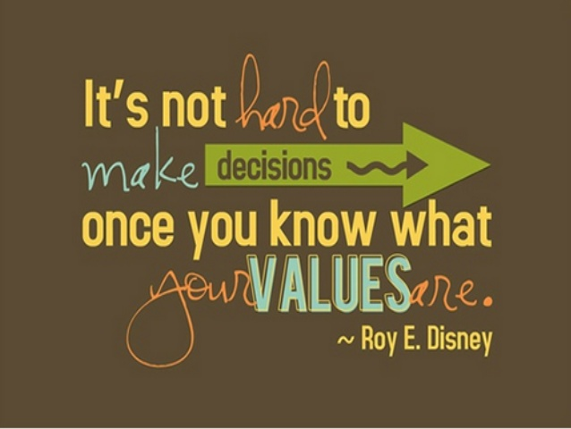

Values
Tuesday 8th March 2022

Slide 2


Opportunity
Collaboration
Trust

Slide 3
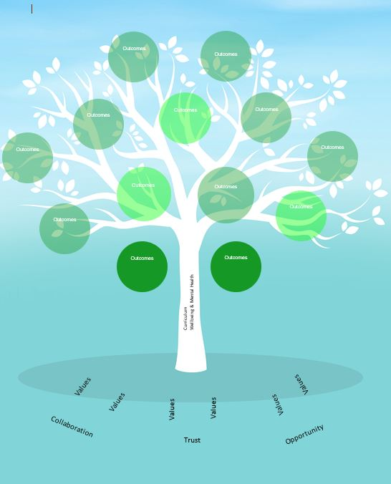
Botley School Aspirations
?
Botley School Values
?

Slide 4

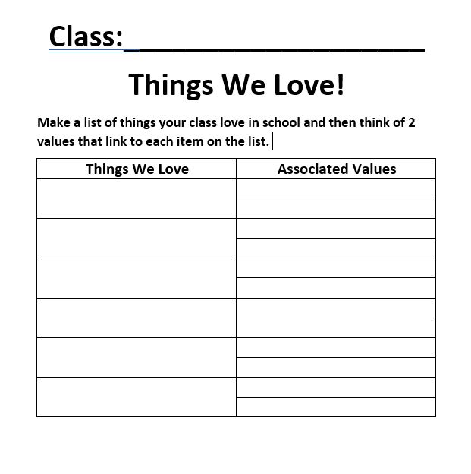
How can we understand each other and recognise our shared values?
You can be as creative as you like about how you record and display your lists in your class
Keep a record that can be given to Mrs Reid.

Slide 5
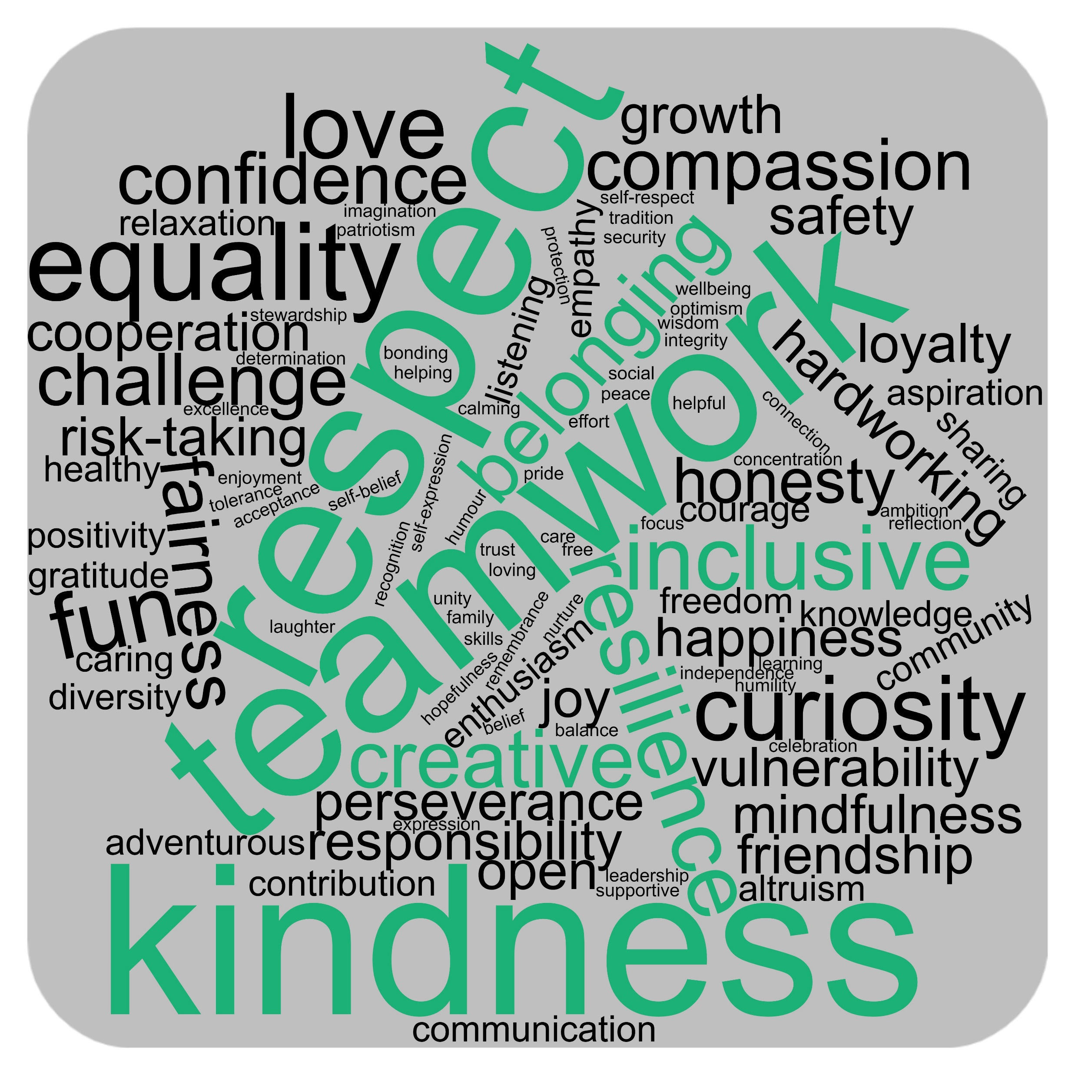
What did we value?

Slide 6






Botley School Values
Kindness
Teamwork
Respect
Resilience
Inclusivity
Creativity

Slide 7
Class Assembly Log
1. Create a class list of definitions for each of our new values
2. Think of a way to display the definitions in your room.
3. Don’t forget to be as creative as you can be with your display

Slide 8

I wonder…?
Reflection Time
How can we show our values each day?
Which of these values do we show most?
You can use the reflection time to say a prayer if you want to.
Who do you think does a brilliant job of demonstrating these values

Slide 9
‘And that's why you should keep on aiming high
Just seek yourself and you will shine’
M-People ‘Search for the Hero’

